Slide 1
Intrusion Detection and Identification Using
Tree-Based Machine Learning Algorithms on DCS Network in the Oil Refinery
NAME: MD KHALIFUL ISLAM ID: 17301114 ST: Abid Hossain; RA: Sania Azhmee
GROUP NO: 19

Slide 2
Introduction
Global CI Interconnectedness
ICS Cyberattack Impact
Colonial Pipeline Example
ICS-IT Integration
Proposed: ML for DCS Intrusion Detection
DCS Vendor-proprietary Protocols
Dataset Collection & Evaluation
ML Model Effectiveness

Slide 3
Background and Related Work
ICS Security Study Overview
Escalating Cyber Threats to ICS
Colonial Pipeline Impact: Real-world Consequences
Introducing Novel Approach: Machine Learning for DCS Security
Leveraging Unique Vendor-specific Protocols
Real-world Data Validation for Robustness
Key Attack Avenues: Phishing, Media, Misconfigurations
Safeguarding DCS Network: Availability, Integrity, Confidentiality

Slide 4
Experiment Setup and Attack Scenarios
Experiment Environment Overview
Collection of Normal and Abnormal Traffic
Simulation of Attack Scenarios
Network Scans and Denial of Service (DoS) Attacks
Layer-based Scan Investigations

Slide 5
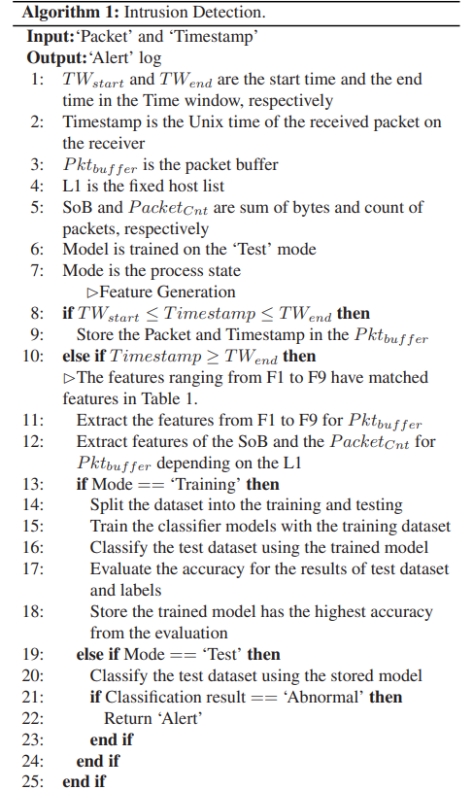
Proposed Intrusion Detection Scheme
Framework Overview: Data Preprocessing and Detection Algorithm
Data Preprocessing: Transformation of Raw Traffic to Feature Vector
Time Window Process and Sliding
Feature Vector Construction: Statistical, Time Window-related, Host-based
Detection Algorithm: Utilizing Tree-based Machine Learning Models
Captured Features: Bytes Count, Packet Count, Multicast, Entropy
Time Window Statistics: Mean, Q1, Q3, Skewness
Host-based Features: Bytes per Second (BPS), Packets per Second (PPS)
Focus on Plant Network (PN) Intrusion Detection
Algorithm 1: Intrusion Detection Process

Slide 6
Performance Evaluation
Metrics Overview (VA):
Confusion matrix analysis
Accuracy, precision, recall, F1-score
Area under the ROC curve
Intrusion Detection (VB1):
Dynamic abnormality detection
Optimal time windows for accuracy
Assess attack scenarios: NMAP Scanner, Scan attacks, DoS attacks
XGBoost classifier excels in accuracy
Attack Identification (VB2):
Identify attack types
Multiclass classification accuracy and ROC curve
XGBoost effectively distinguishes attacks

Slide 7
Conclusion
Novel DCS Attack Detection Method
Uses BPS and PPS Changes
Doesn't Require DCS Configuration Changes
Thank you for your time and attention 🙂

